Slide 1
Agenda for GEOG260/360 GIS & Land Change Models
September 25
See grades for Assignment 2
Discuss Assignment 3, its Rubric, and TOC curves
September 27
Tanner’s office hours in the Academic Commons are 10:30am-noon for today
Submit Assignment 3 by 4pm on Canvas
Get familiar with the Extract module
Get instructions for Assignment 4
October 2
Discuss Assignment 4
October 4
Submit Assignment 4 by 4pm on Canvas
Get instructions for Assignment 5

Slide 3
Assignment 3
Use the maps in ForestOtherBuilt2.zip from Canvas. Perform two simulations of Geomod that use 1985Built as the Beginning landuse image, Mask01 as mask, 1985 as beginning time, 1999 as ending time, 14 as time step, neighborhood search mode unconstrained, Driver map is 1971landuse21cats01 with weight as 1, do not do environmental impact analysis, and do not output interim time images, make the output name match the name on the first panel. For Run 1, set the quantity to make the simulation match the validation map at 1999. For Run 2, set the quantity for State 1 END to 40456, which is half of State 1 BGN.
For both runs, perform validation by using CROSSTAB with 1985Built, 1999Simulation, 1999Built and mask01. Make an intuitive color palette and edit the legend to describe in words each combination from the CROSSTAB. Report the number of pixels of each category in the CROSSTAB.
Submit one PPTX file that has exactly four slides. Slide 1 is a title slide with the author(s) name(s). Slide 2 shows the suitability map and validation map for the first run. Slide 3 shows the suitability map and validation map for the second run. On slides 2 and 3, explain the relationship between the number of false alarms and the number of misses for each run. Slide 4 shows and explains the TOC curve on the next slide. State the points where each run would appear on the TOC curve. Interpret the shape of the TOC curve in terms of the 1971landuse categories. Explain what we learn from the slopes of the segments of the curve near the origin, compared to the slopes of the segments of the curve near the upper right corner. Explain the role of stationarity in the interpretation of the TOC curve.

Slide 4
Submit exactly one slide with the title and student(s) name(s). 5 points
Submit exactly one slide that includes the following bullets for the first run. 30 points
The validation map with the map title, updated legend, scale bar, and north arrow. 10 points
The suitability map with the map title, legend, scale bar, and north arrow. 10 points
The report with the number of pixels of each category in the CROSSTAB. 5 points
The paragraph that explains the relationship between the number of false alarms and the number of misses. 5 points
Submit exactly one slide that includes the following bullets for the second run. 30 points
The validation map with the map title, updated legend, scale bar, and north arrow. 10 points
The suitability map with the map title, legend, scale bar, and north arrow. 10 points
The report with the number of pixels of each category in the CROSSTAB. 5 points
The paragraph that explains the relationship between the number of false alarms and the number of misses. 5 points
Submit exactly one slide that includes the following bullets. 30 Points
The paragraph with the interpretation of the shape of the TOC curve in terms of the 1971 land use categories. 10 points
The paragraph with the explanation of the differences in slopes between segments of the curve near the origin and near the upper right corner. 10 points
The paragraph with the explanation of the role of stationarity in the interpretation of the TOC curve. 10 points
Bonus 5 points

Slide 5
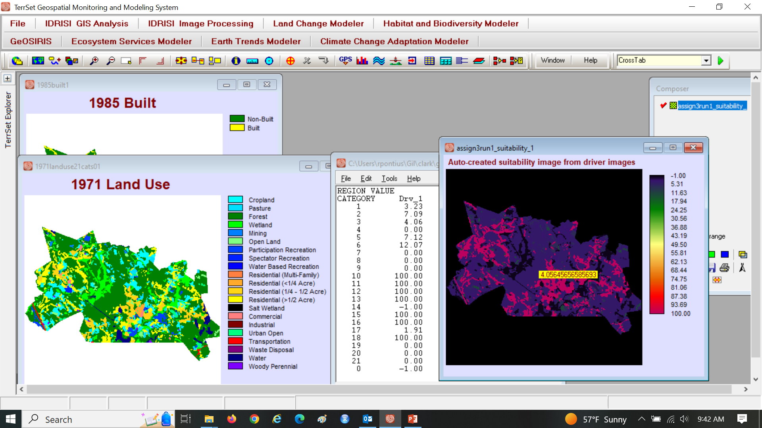
Assignment 3

Slide 6
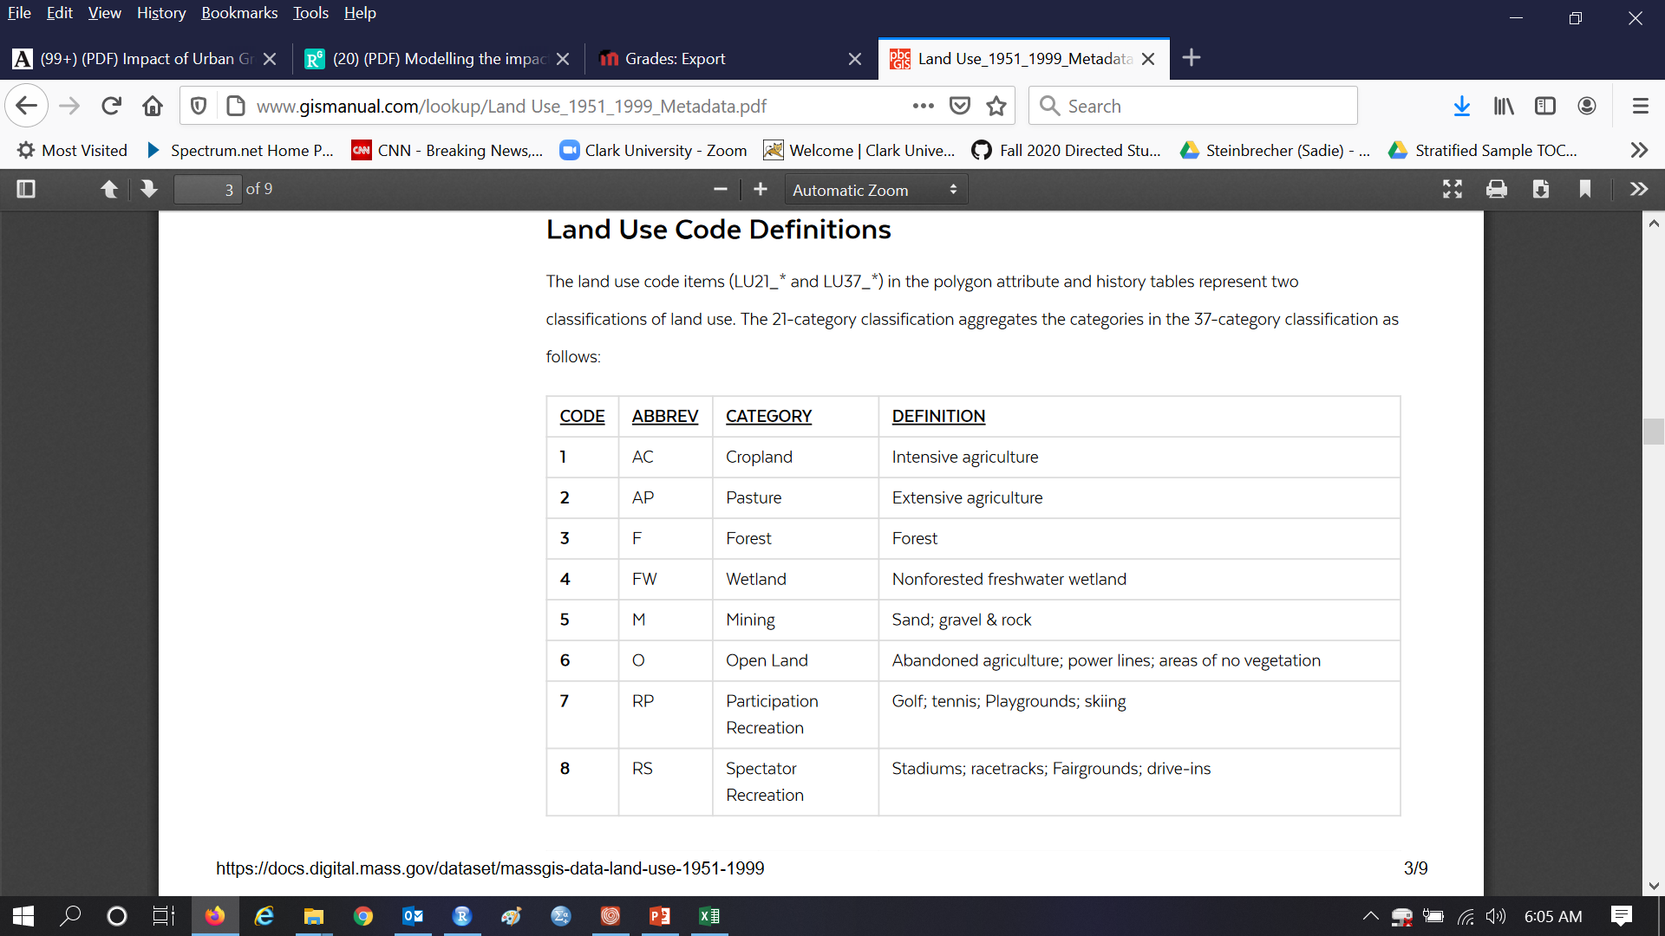
Definitions for 21 landuse categories of MassGIS http://www.gismanual.com/lookup/Land%20Use_1951_1999_Metadata.pdf

Slide 7
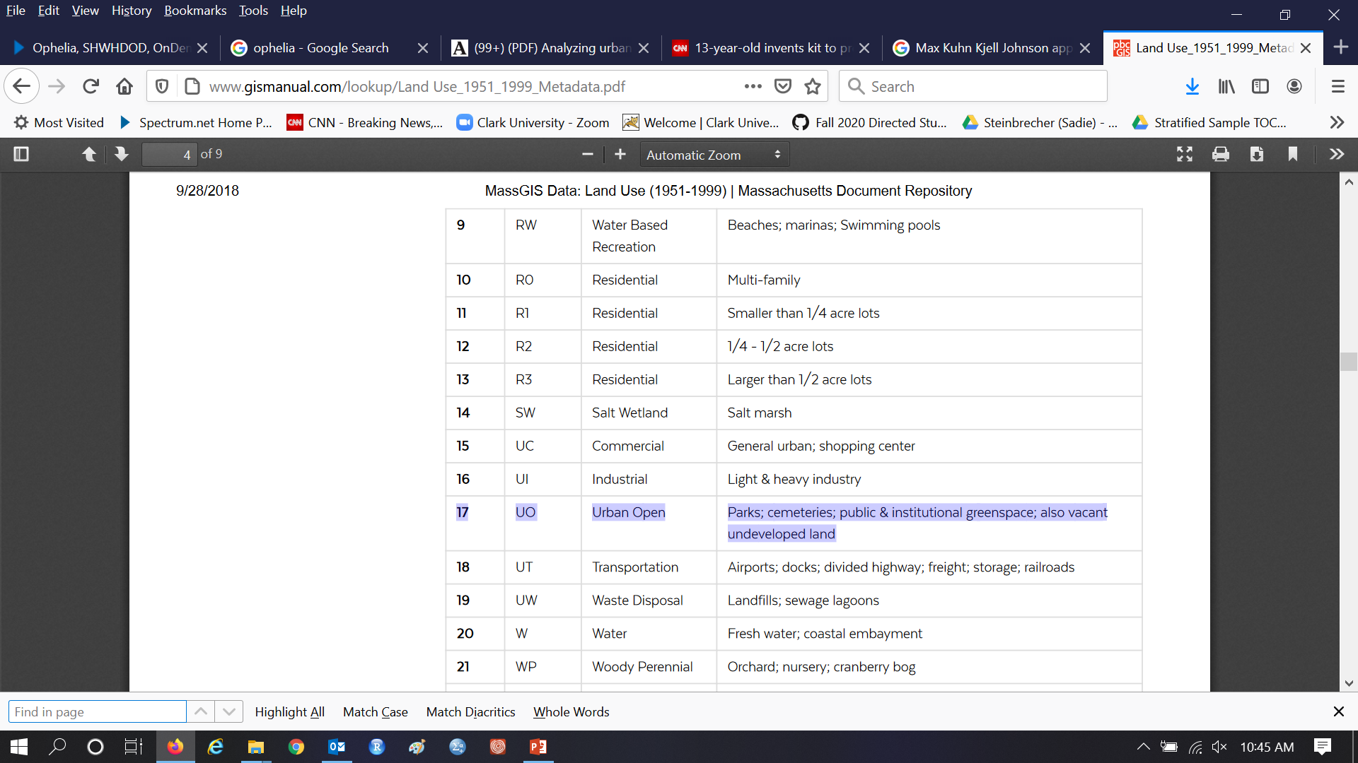
Aandishah asks the meaning of Urban Open http://www.gismanual.com/lookup/Land%20Use_1951_1999_Metadata.pdf

Slide 8
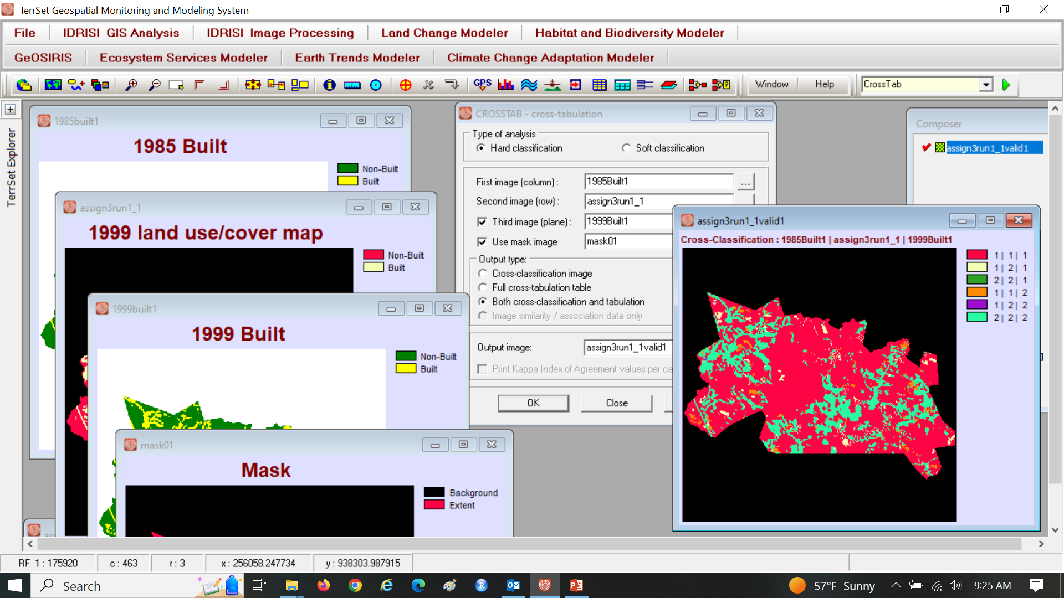
Assignment 3

Slide 9
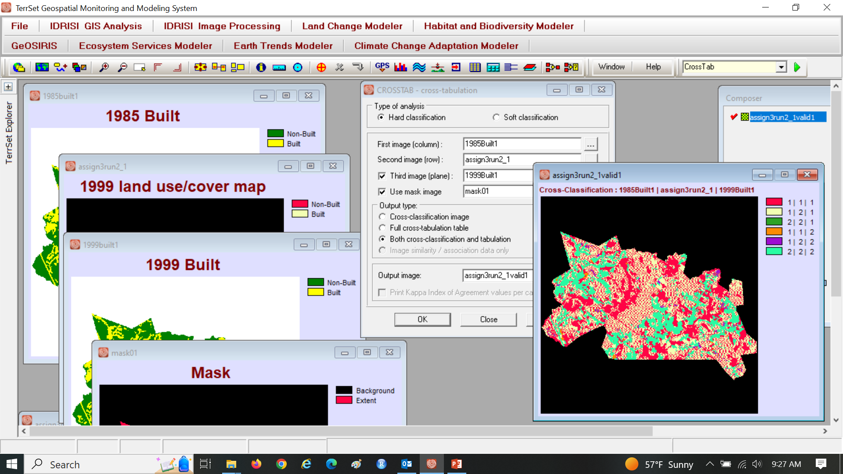
Assignment 3

Slide 10
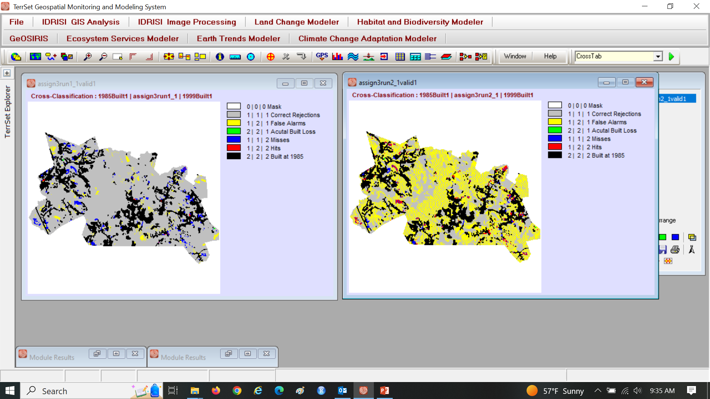
Assignment 3

Slide 11
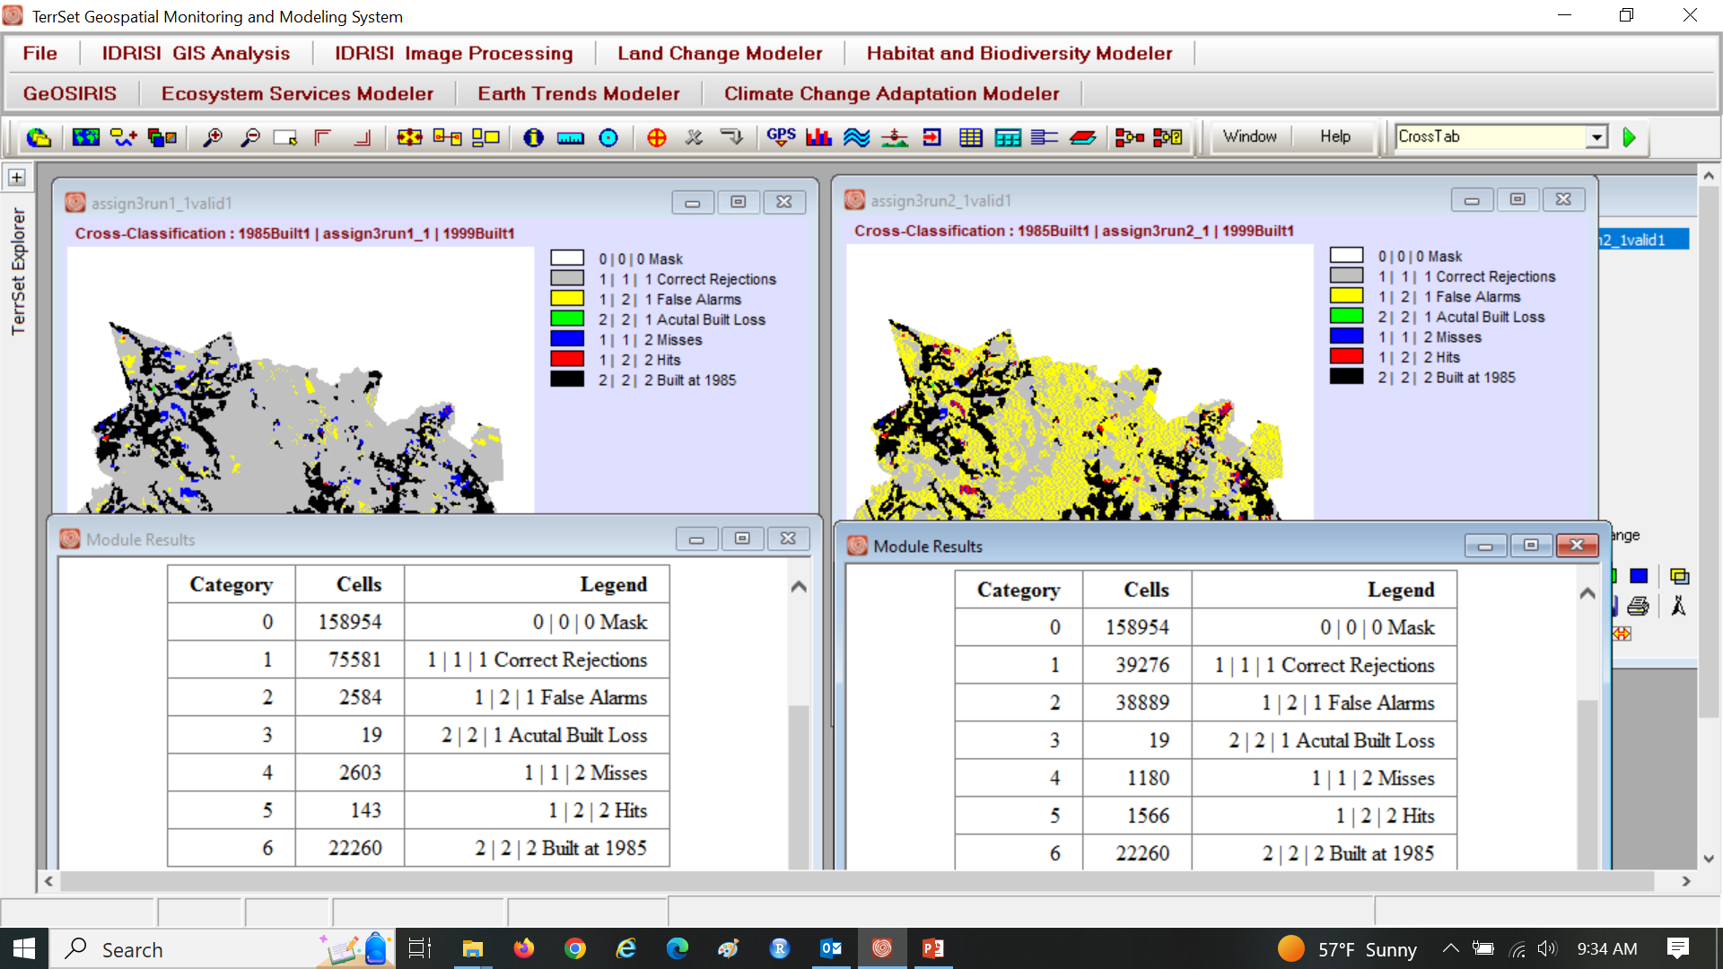
Assignment 3

Slide 12
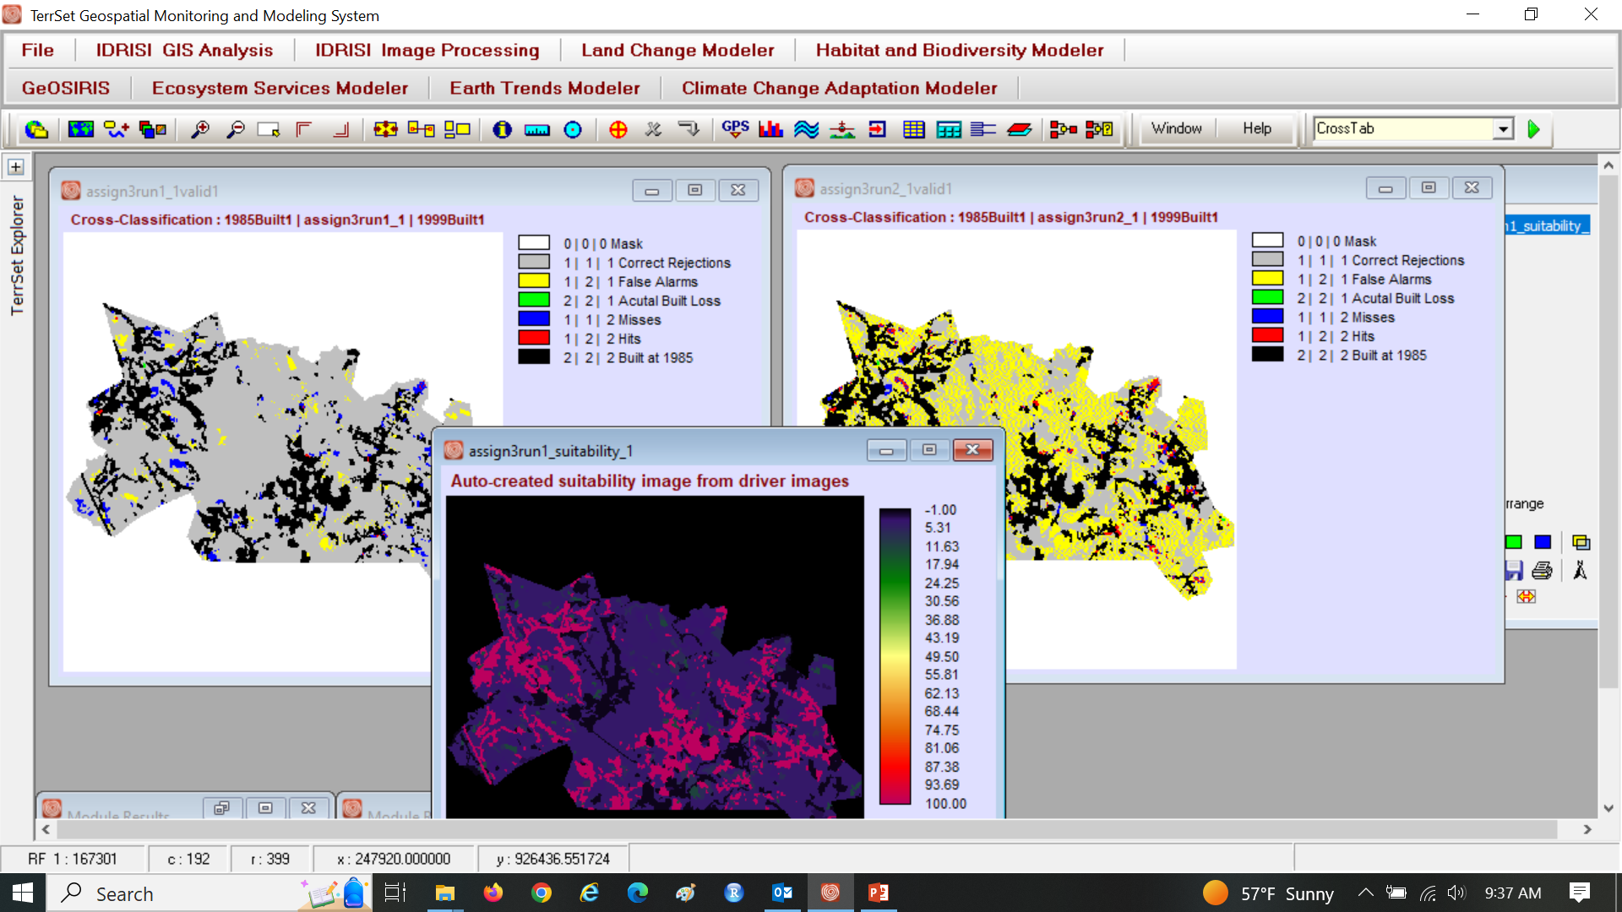
Assignment 3

Slide 13
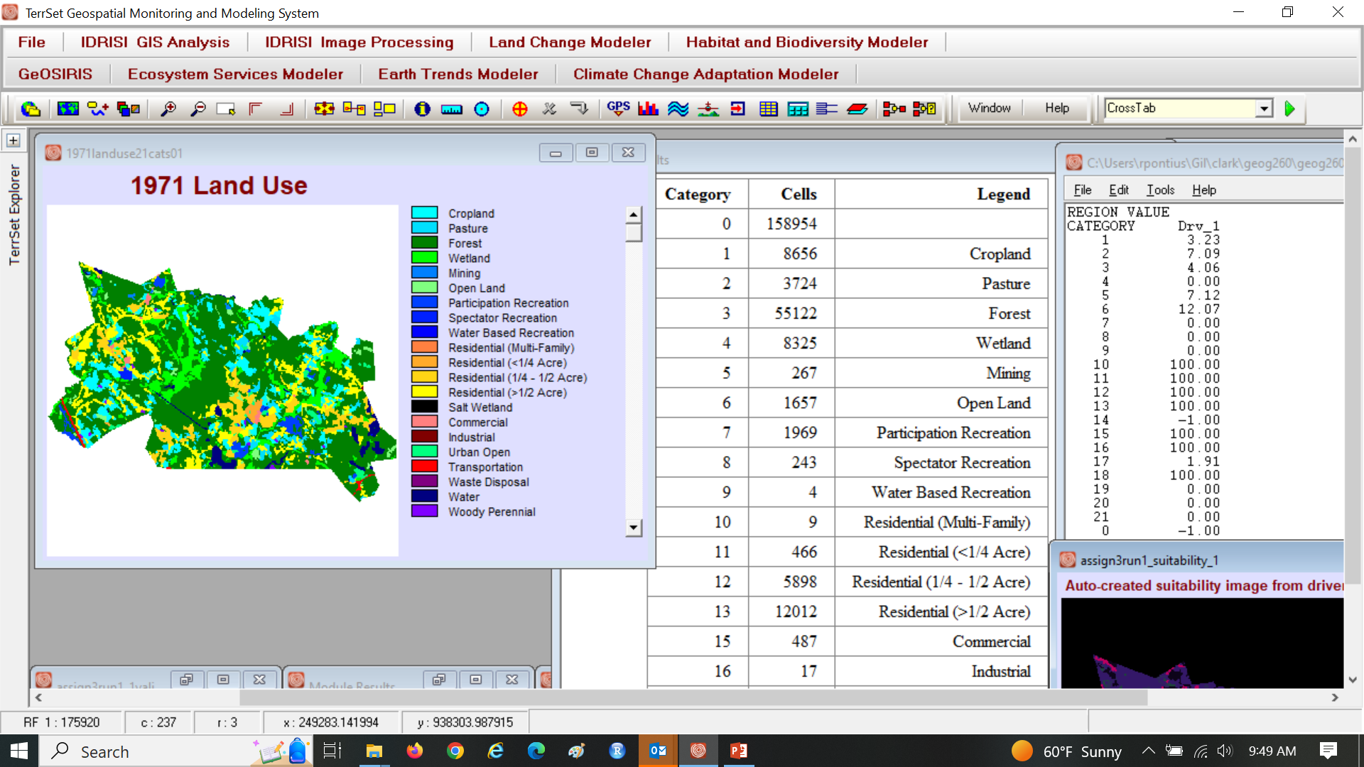
Assignment 3

Slide 14
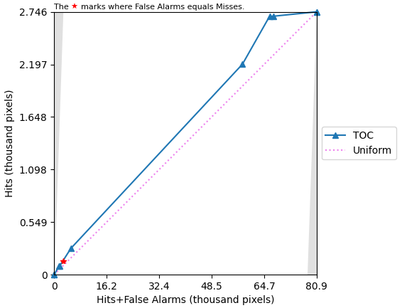
TOC curve for Assignment 3

Slide 15
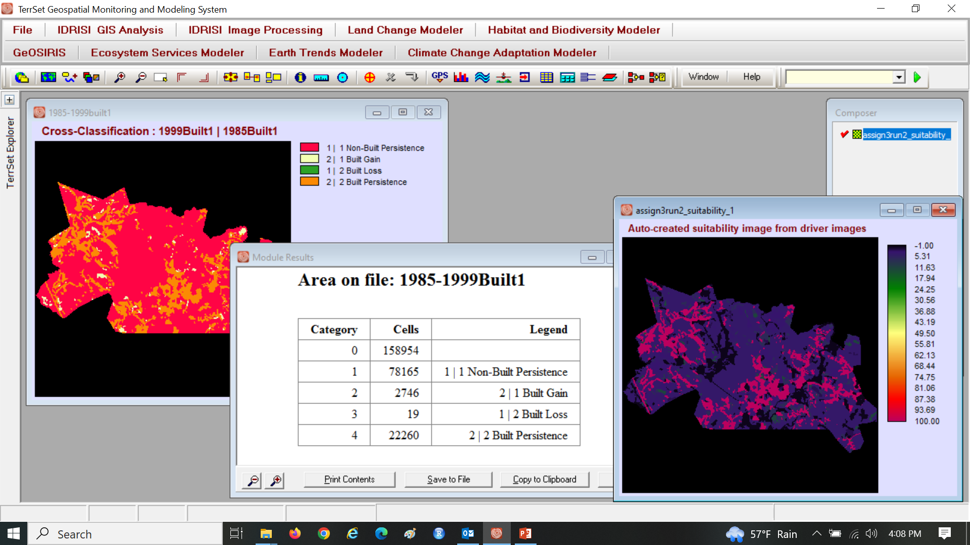
Assignment 3

